Slide 1



VISIT
OUR WEBSITE!
TACTILEPICTUREBOOKS.ORG
TAKE it, PRINT it, READ it
MAKE 3D PRINTING AS EASY AS 2D PAPER PRINTING

Slide 2
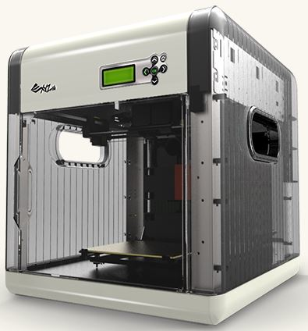
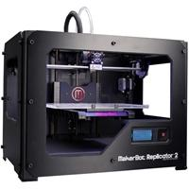
Why 3D printing? Have you seen a 3D printer?
$2,000
$700

Slide 3



What is your favorite Children’s book? Why?

Slide 4
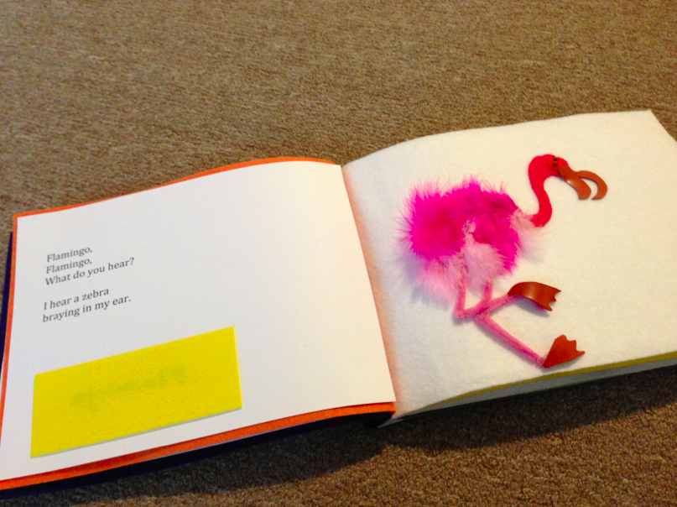
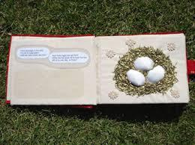
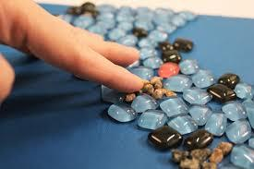
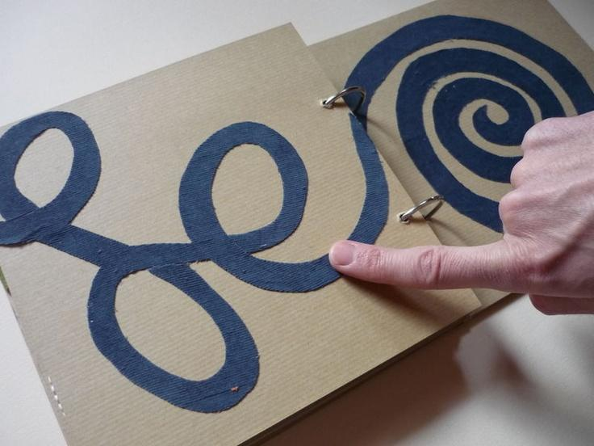
What are “Good” Tactile Pictures?
Texture
Abstract
?

Slide 5
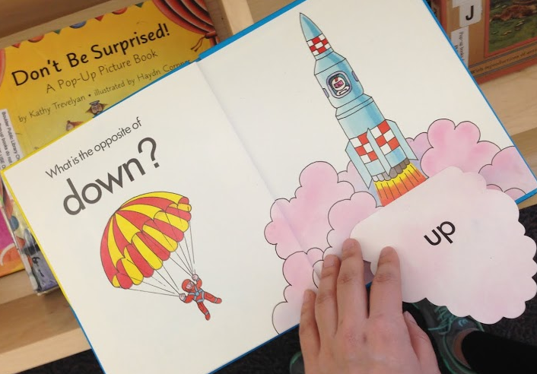
How do you transcribe following picture?

Slide 6
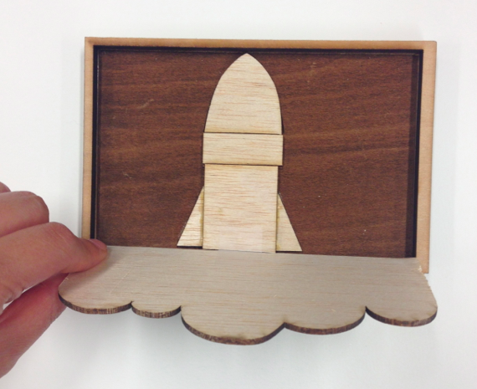
Do you think it works?

Slide 7
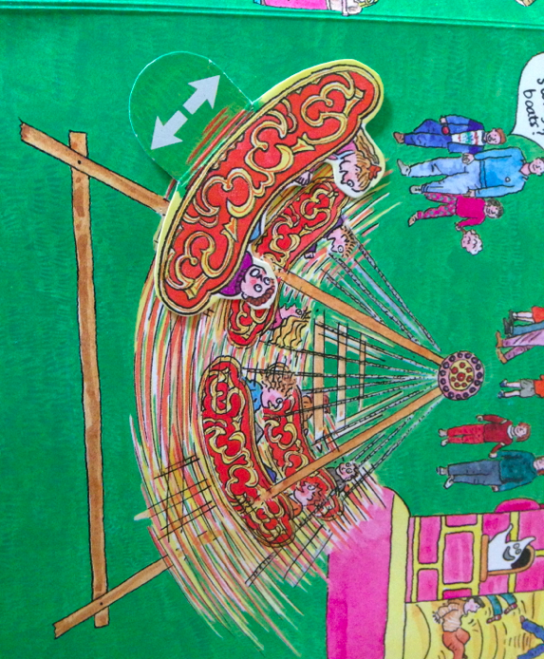
How do you transcribe this pictures?

Slide 8
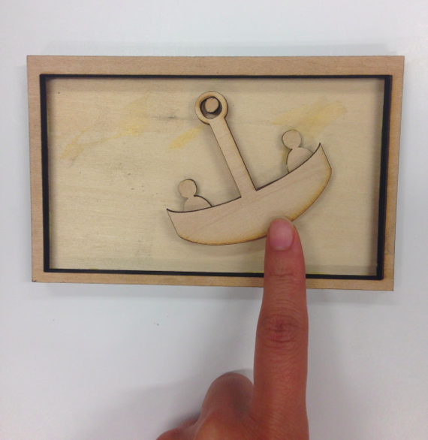
Do you think it works?

Slide 9
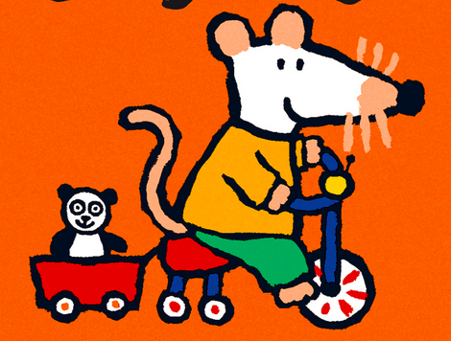
How do you think this?

Slide 10
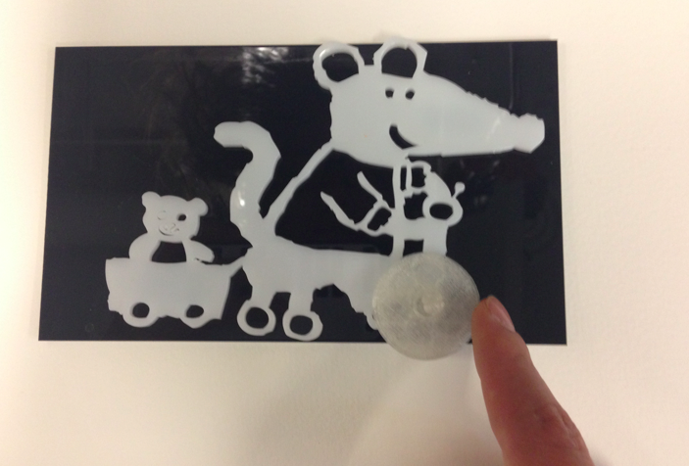
Can this work?

Slide 11
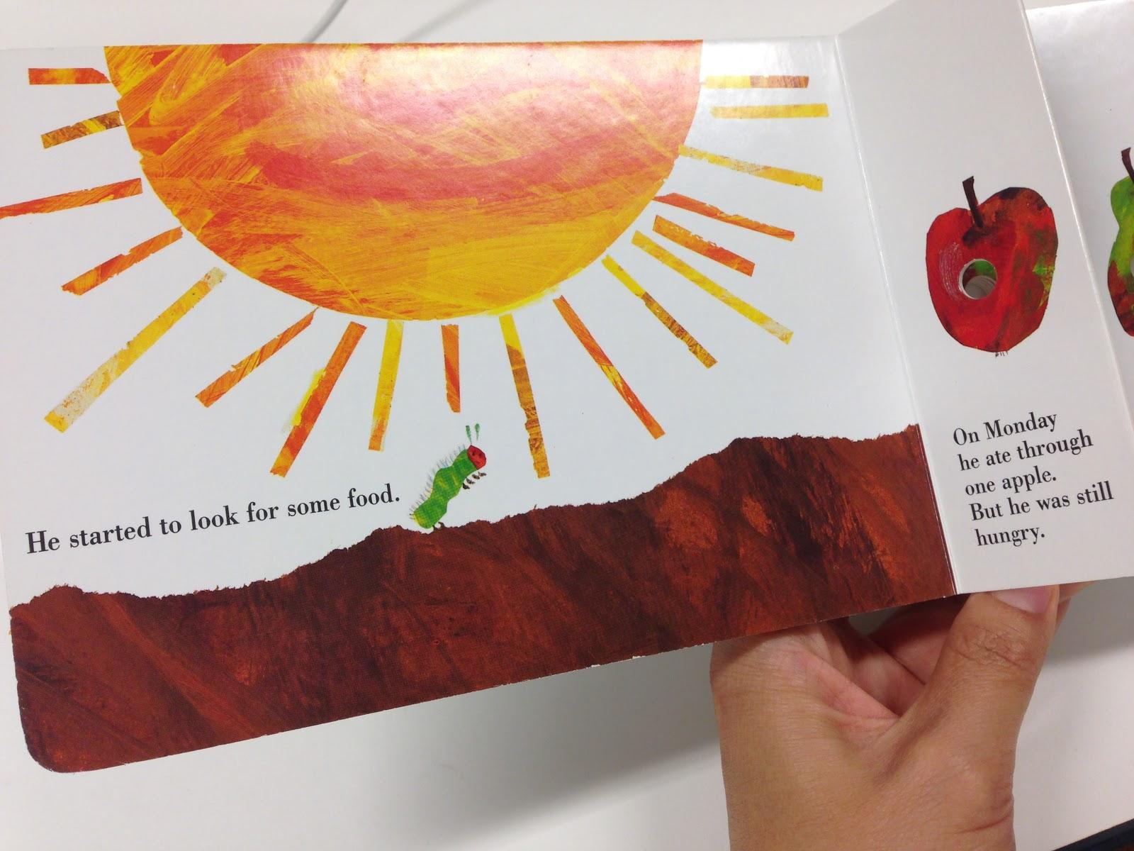
What about this?

Slide 12
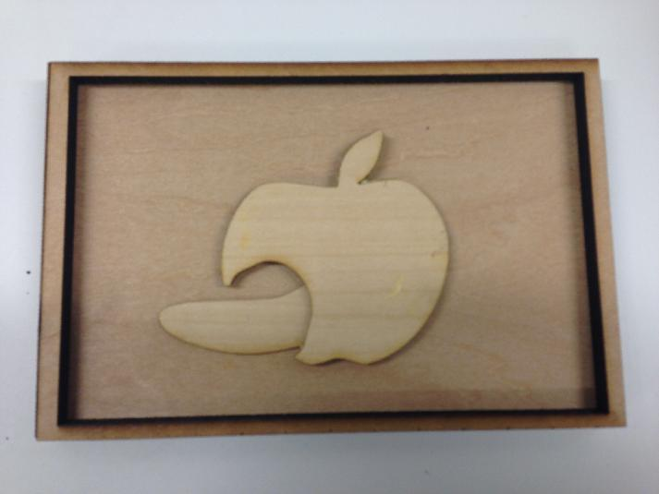
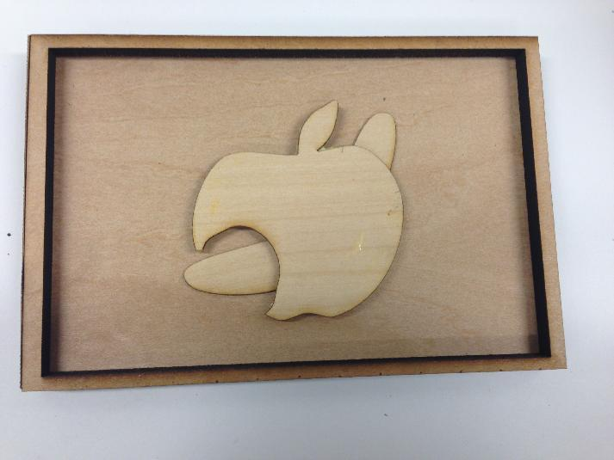
Does this convey the main idea?

Slide 13
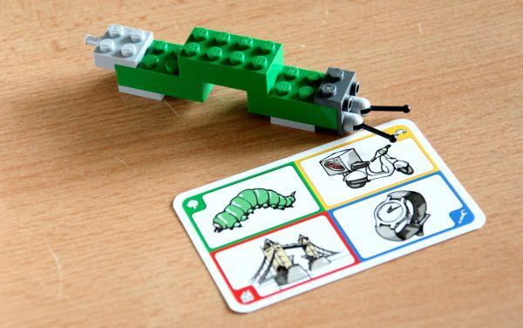
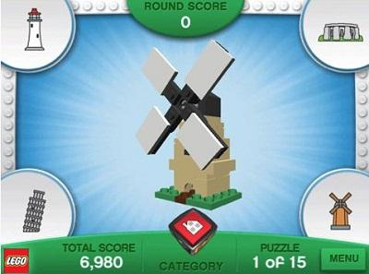
Lego Creationary

Slide 14
Lego Creationary

Slide 15




What are we doing today?
TACTILIZOR

Slide 16



Send a picture of your blocks to...
@iamqubick
720-308-4547
qubick.kim@gmail.com

Slide 17
Let’s Play a Pictionary!

Slide 18
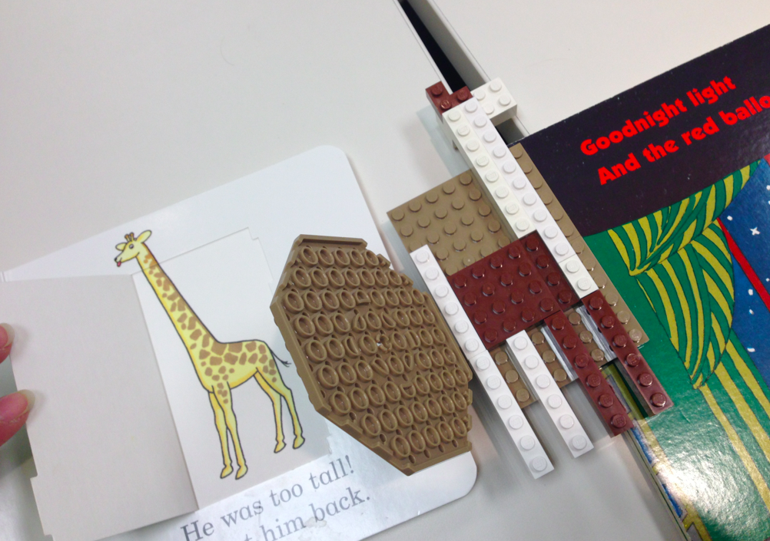
Last time, high school students created

Slide 19
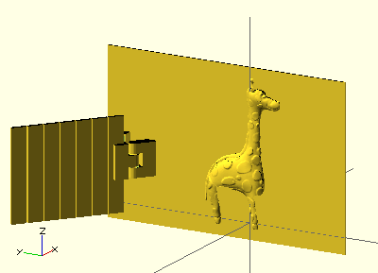
So it was transcribed in 3D,

Slide 20
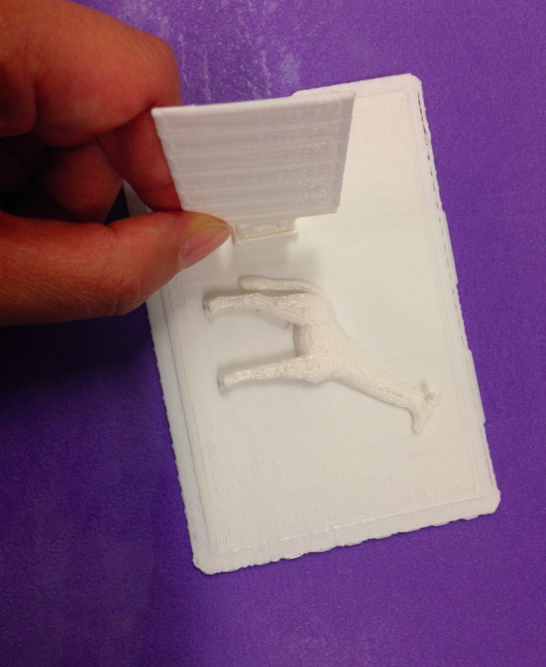
Finally printed in 3D !!!

Slide 21
Contact Us!!
TACTILEPICTUREBOOKS.ORG
BUILD it, CONVERT it, PRINT it
MAKE 3D DESIGNING AS EASY AS PAPER DRAWING

